Slide 1
Transfer learning for time series classification
Transfer Learning CS 598
Group 39

Slide 2
Main contribution
The authors fill the gap by investigating how transfer learning works for CNNs on TSC problem sets. Their experiments revealed that transfer learning can improve or degrade prediction power of the model. Hence, the authors propose a new method for predicting best source dataset for a given target dataset - Dynamic Time Warping.
The authors hypothesized that the learned shapelets (subsequences) might not be specific to one dataset and could occur in other unseen datasets too. Shapelets are small subseries, or parts of the timeseries, that are informative or discriminative for a certain class.
Additionally, the authors take a pre-designed deep learning model without modifying it nor adding regularizers. This enabled us to solely attribute the improvement in accuracy to the transfer learning feature.

Slide 3
Related Work
The work referenced below pertains to CNNs being used for Time series problem sets:
Cost-Sensitive Convolution based Neural Networks for Imbalanced Time-Series Classification - This paper aimed at tackling imbalanced time-series classification (ITSC) problems with deep learning. An adaptive cost-sensitive learning strategy was proposed to modify temporal deep learning models. Experimental results show that the proposed method outperforms other state-of-the-art models on imbalanced time-series classification tasks.
Data Augmentation for Time Series Classification using Convolutional Neural Networks - The paper proposes a data augmentation approach for time series classification using convolutional neural networks (CNNs). The approach involves generating new samples by applying random transformations such as scaling and shifting to the original time series data. Experimental results demonstrate that the proposed method improves classification performance and outperforms other data augmentation techniques on various benchmark datasets.

Slide 4
Related Work Cont.
Other Deep Learning models at work in Time series data:
Spatio-Temporal Neural Networks for Space-Time Series Forecasting and Relations Discovery - The authors introduce a dynamical spatio-temporal model formalized as a recurrent neural network for forecasting time series of spatial processes. Experimental results show that the proposed method outperforms other state-of-the-art models on imbalanced time-series classification tasks.
Boosting Deep Learning Risk Prediction with Generative Adversarial Networks for Electronic Health Records - In this work, the authors propose a general deep learning framework which boosts performance with limited EHR data. The model takes plausible labeled EHR data by mimicking real patient records, to augment the training dataset. They use this generative model together with a convolutional neural network (CNN) based prediction model to improve the onset prediction performance.

Slide 5
Methodology Overview
A transfer learning approach for, involving two stages: pretraining and fine-tuning.
In the pretraining stage, a diverse dataset of time series is used
In the fine-tuning stage, the pre-trained network is fine-tuned on the target time series classification task with a smaller dataset of labeled time series.
The problem boils down to choosing a target dataset for fine-tuning the network

Slide 6
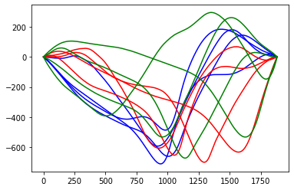
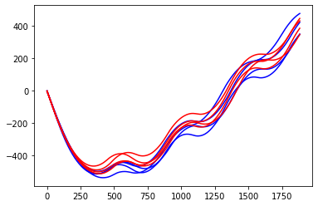
Visualization of Datasets - picking the best source dataset?
These figures show per-class cumulative sum of a time series for different classes each shown with a separate color
InlineSkate TRAIN Dataset 10 classes (showing 3)
HandOutlines TRAIN Dataset with 2 classes

Slide 7
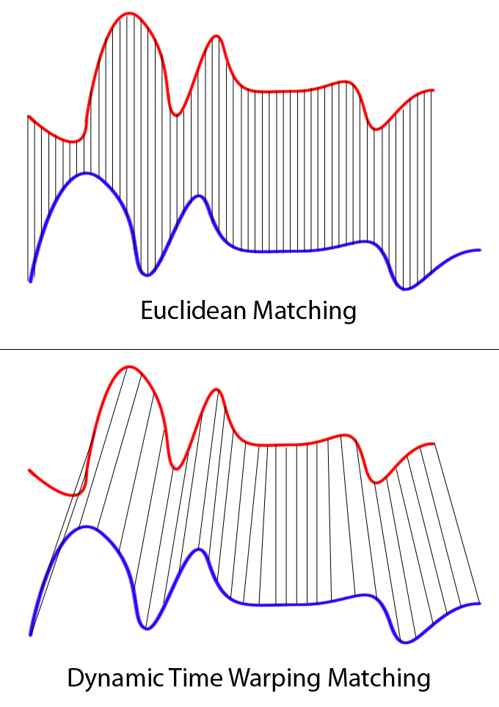
DTW
DTW computes the distance using the best possible alignment of the time series
Image Reference : https://paperswithcode.com/method/dtw

Slide 8
DTW Algorithm
def dtw(series_1, series_2, norm_func = np.linalg.norm):
matrix = np.zeros((len(series_1) + 1, len(series_2) + 1))
matrix[0,:] = np.inf
matrix[:,0] = np.inf
matrix[0,0] = 0
for i, vec1 in enumerate(series_1):
for j, vec2 in enumerate(series_2):
cost = norm_func(vec1 - vec2)
matrix[i + 1, j + 1] = cost + min(matrix[i, j + 1], matrix[i + 1, j], matrix[i, j])
matrix = matrix[1:,1:]
print(matrix)
dtw_distance = 0
for i in range(len(series_1)-1):
dtw_distance += min(matrix[i,i],matrix[i+1,i],matrix[i,i+1])
print(dtw_distance)

Slide 9
DTW Algorithm
def dtw(series_1, series_2, norm_func = np.linalg.norm):
matrix = np.zeros((len(series_1) + 1, len(series_2) + 1))
matrix[0,:] = np.inf
matrix[:,0] = np.inf
matrix[0,0] = 0
for i, vec1 in enumerate(series_1):
for j, vec2 in enumerate(series_2):
cost = norm_func(vec1 - vec2)
matrix[i + 1, j + 1] = cost + min(matrix[i, j + 1], matrix[i + 1, j], matrix[i, j])
matrix = matrix[1:,1:]
dtw_distance = 0
for i in range(len(series_1)-1):
dtw_distance += min(matrix[i,i],matrix[i+1,i],matrix[i,i+1])
A = [1, 1, 2, 2, 2.42, 3, 2, 1]
B = [1, 2, 3, 2, 2.13, 1]
0 | 1 | 3 | 4 | 5.13 | 5.13
0 | 1 | 3 | 4 | 5.13 | 5.13
1 | 0 | 1 | 1 | 1.13 | 2.13
2 | 0 | 1 | 1 | 1.13 | 2.13
3.42 | 0.42 | 0.58 | 1 | 1.29 | 2.55
5.42 | 1.42 | 0.42 | 1.42 | 1.87 | 3.29
6.42 | 1.42 | 1.42 | 0.42 | 0.55 | 1.55
6.42 | 2.42 | 3.42 | 1.42 | 1.55 | 0.55
Time Complexity O(m * n)

Slide 10
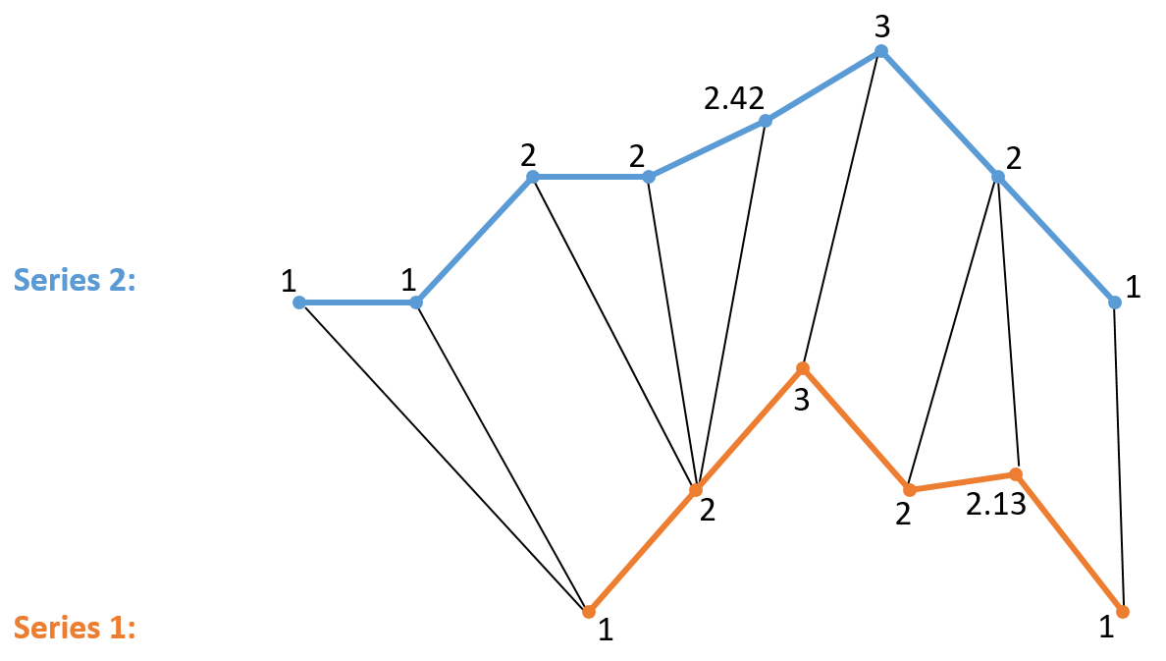

Slide 11
DTW
DTW computes the distance using the best possible alignment of the time series
For each dataset, there are 1000-2000, time series, so how to find best source dataset using these many data points?
Image Reference : https://paperswithcode.com/method/dtw

Slide 12
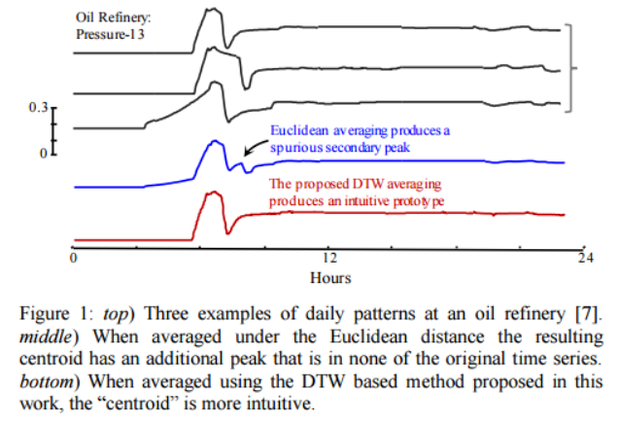
DBA
Finding a per-class prototype using the DBA method
The per class prototype is computed by using a measure of centers (medoid) for the set of time series in the corresponding class.
Image Reference : https://blog.acolyer.org/2016/05/13/dynamic-time-warping-averaging-of-time-series-allows-faster-and-more-accurate-classification/

Slide 13
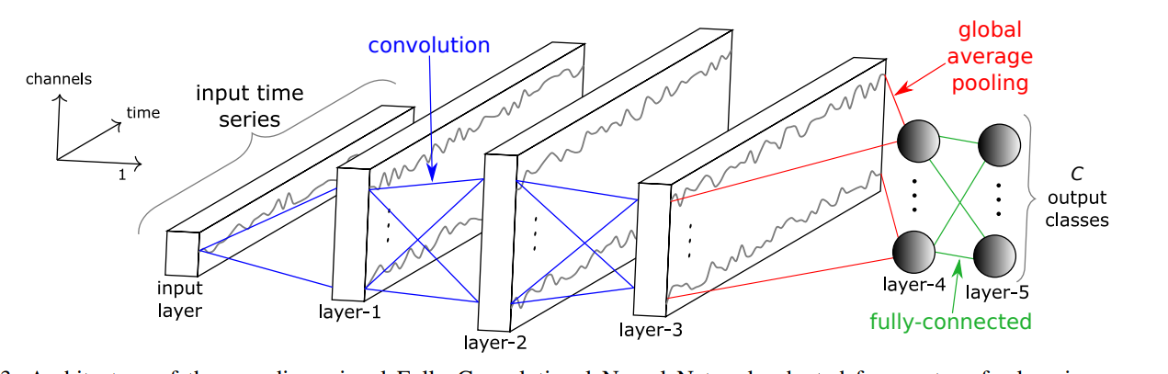
State of Art FCN

Slide 14
Network Adaptation - Transfer Learning
Given a source dataset Ds and a target dataset Dt, the authors first train the network on Ds.
Then remove the last layer and replace it with another softmax layer whose number of neurons is equal to the number of classes in the target dataset Dt
A major challenge is handling time series of different lengths
using global average pooling layer

Slide 15
Experiments
UCR - 85 time series datasets - an important resource in Time Series data mining community
The datasets already have been z-normalized to have a mean equal to zero and a standard deviation equal to account for discrepancies due to magnitude value
For each pair of datasets (D1 and D2) in the UCR archive we need to perform two experiments:
• D1 is the source dataset and D2 is the target dataset.
• D1 is the target dataset and D2 is the source dataset.
Thus a total of 7140 (⁸⁵C₂*2) experiments for the 85 datasets in the archive.
UCR Time Series Archive : https://www.cs.ucr.edu/~eamonn/time_series_data/

Slide 16
Results
Improvement measure = Percentage of accuracy variation w.r.t. Original value
=
Positive values indicate an increase in performance, while negative values indicate a decrease in performance when fine-tuning a pre-trained model.
This improvement or deterioration in CNN’s performance is caused by the choice of source dataset for the given target dataset.
Naive Transfer Learning:
Target dataset: Random selection of source dataset for pre-training the transfer model. Positive example - using MALLAT as source dataset gives accuracy = 93.3% Negative example -using FaceFour as source dataset gives accuracy = 16.7%
Smart transfer Learning: We chose the source dataset by computing the nearest neighbor for a target dataset based on the above similarity measure, to achieve positive transfer.
A heatmap results for accuracy improvement over all 2 * ⁸⁵C₂ inter-dataset transfer are mentioned on next slide.

Slide 17
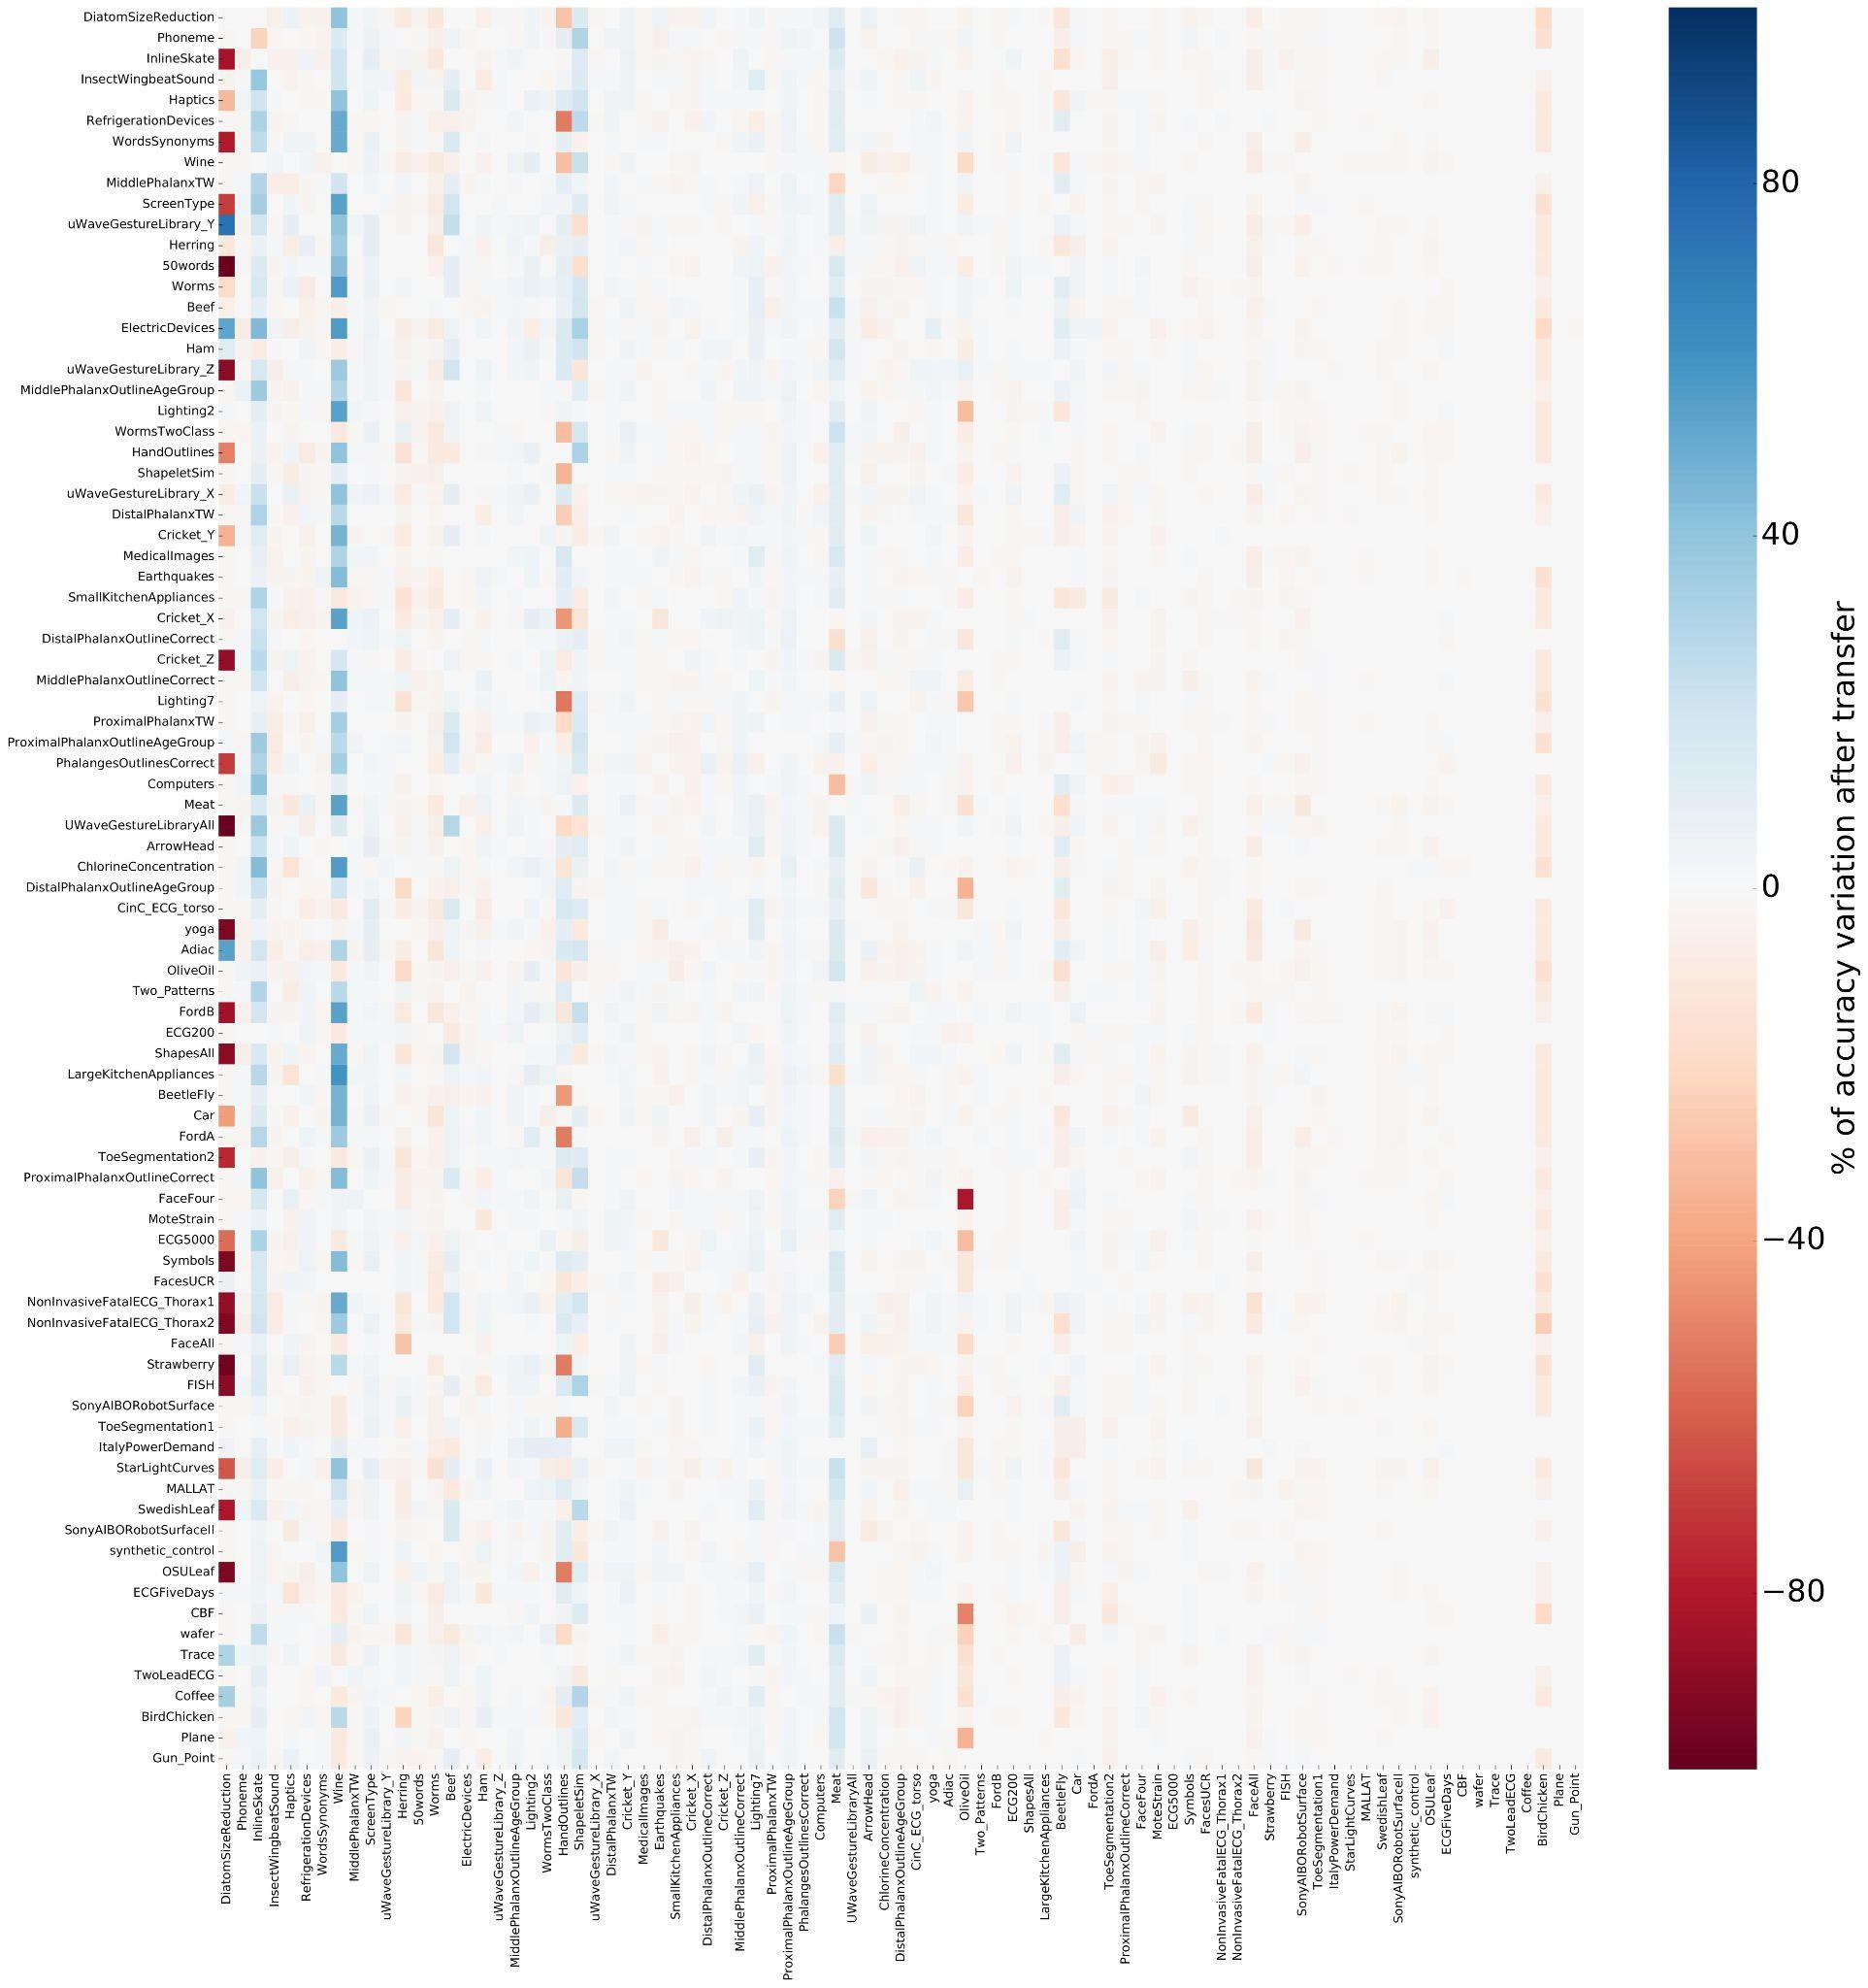
The variation in percentage over the original accuracy when fine tuning a pre-trained model. The rows’ indexes correspond to the source datasets and the columns’ indexes correspond to the target datasets. The red color shows the extreme case where the chosen pair of datasets (source and target) deteriorates the network’s performance. Where on the other hand, the blue color identifies the improvement in accuracy when transferring the model from a certain source dataset and fine-tuning on another target dataset. The white color means that no change in accuracy has been identified when using the transfer learning method for two datasets.

Slide 18
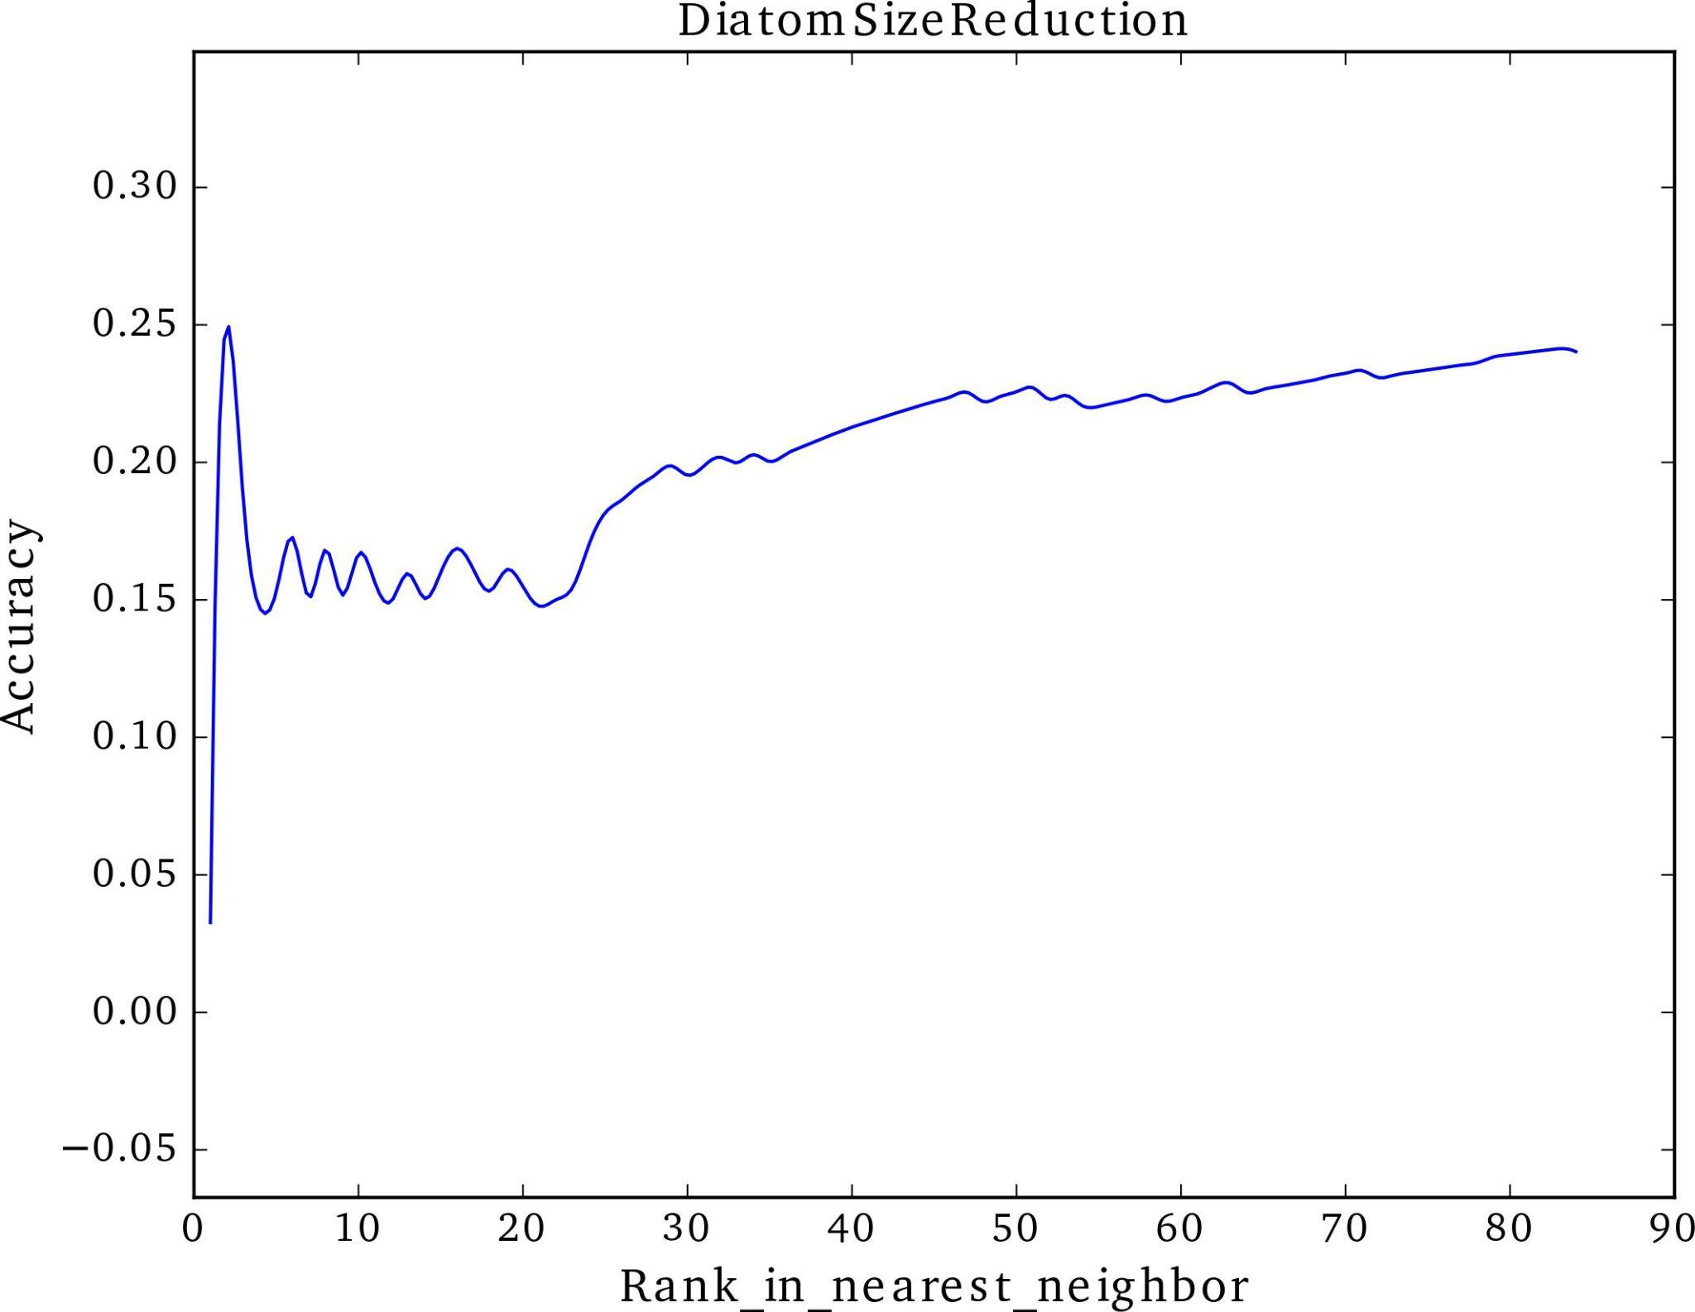
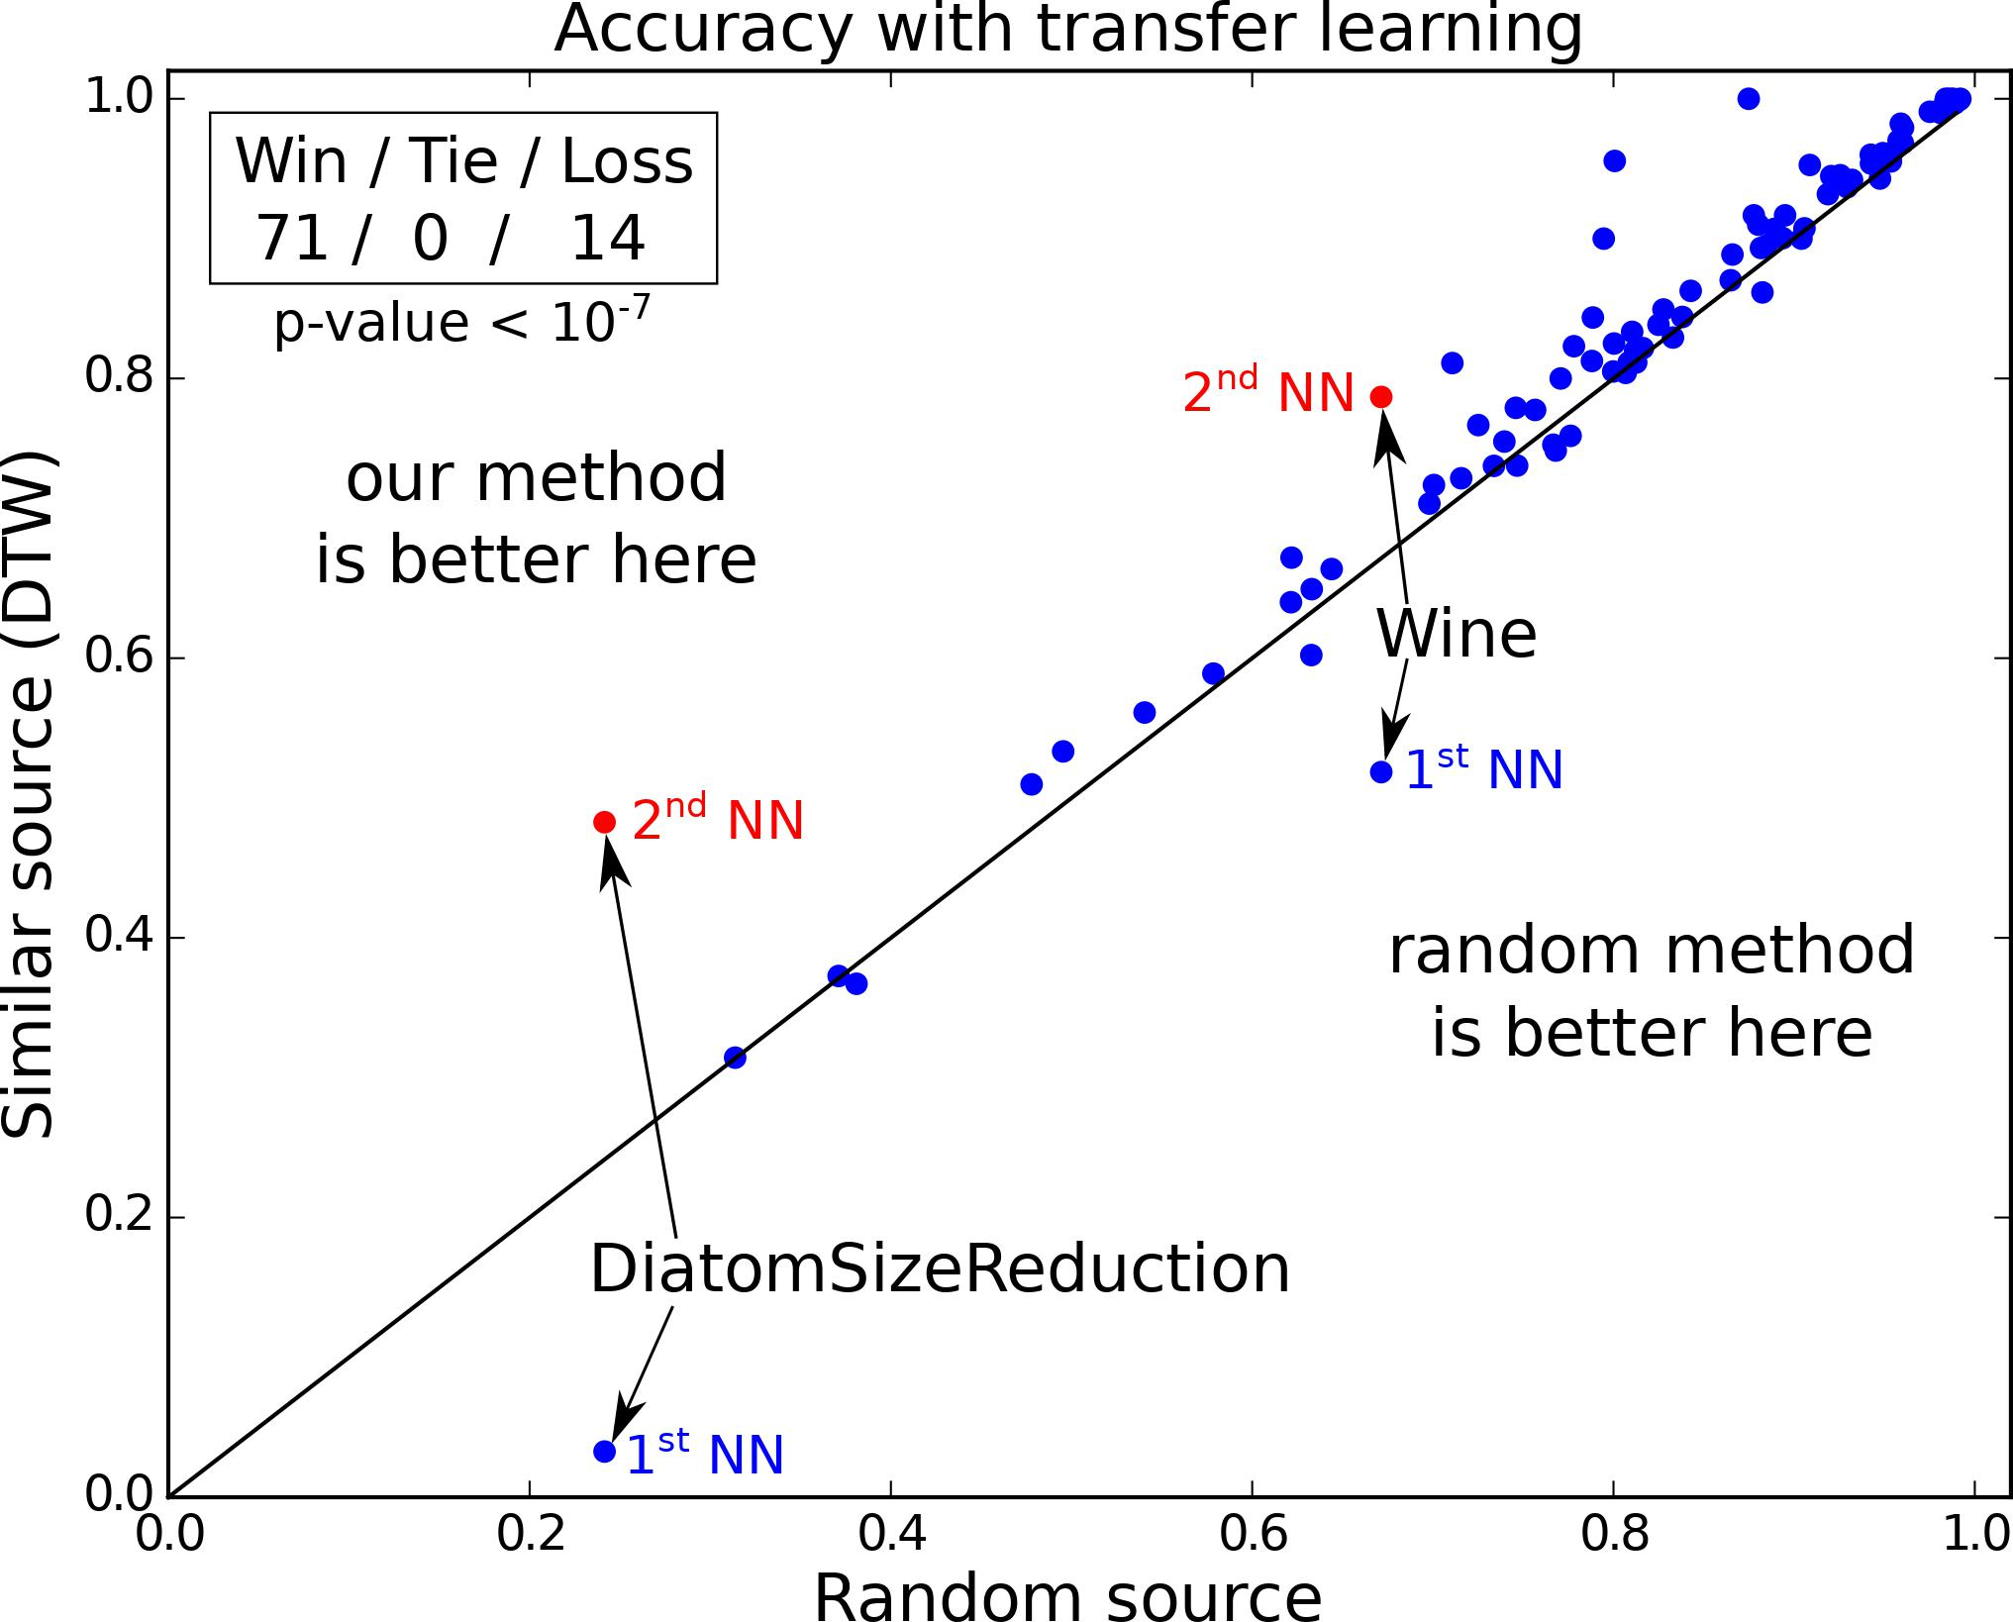
Case Studies on selected target datasets:
DiatomSizeReduction, Wine: Nearest neighbour was not the best choice for transferring model, the 2nd NN gave best accuracy(3.3% -> 46.7%) and (51.9% -> 77.8%) respectively. This indicates that certain improvements could be incorporated to this inter-datasets similarity calculation such as adding a warping window or changing the number of prototypes for each class.

Slide 19
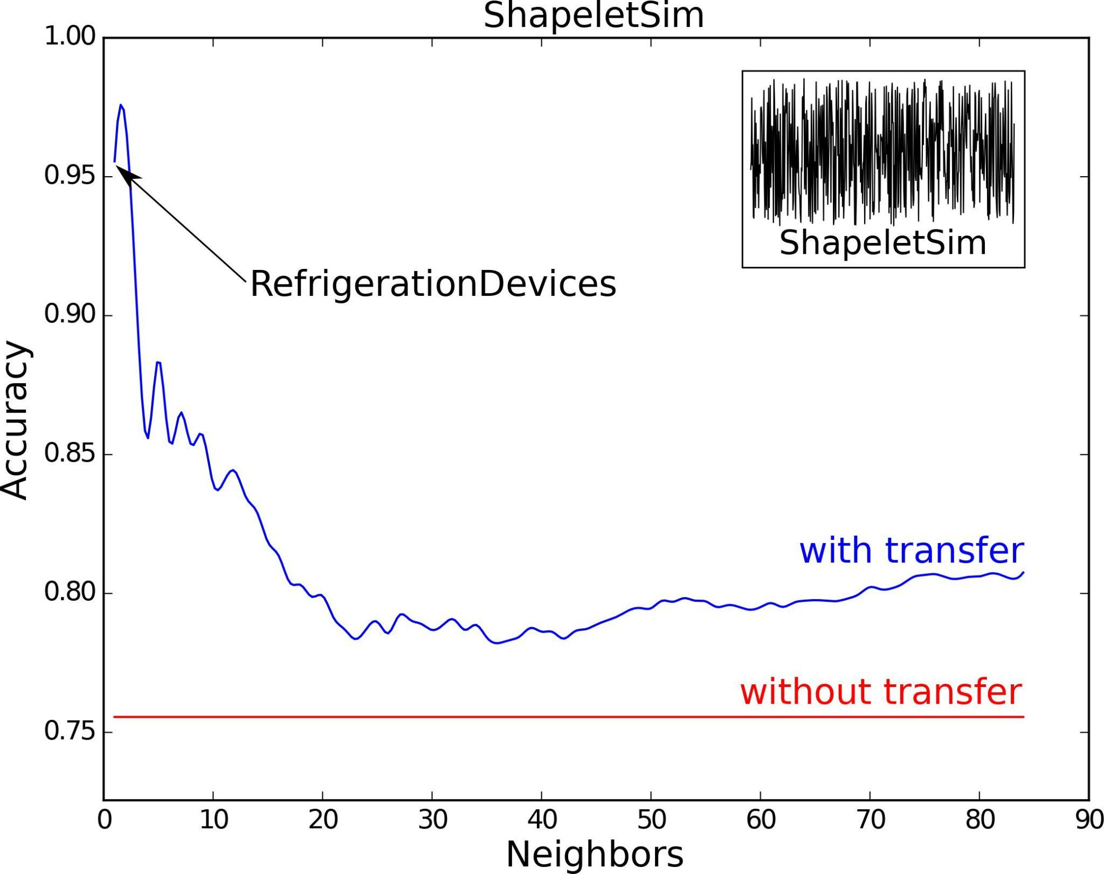
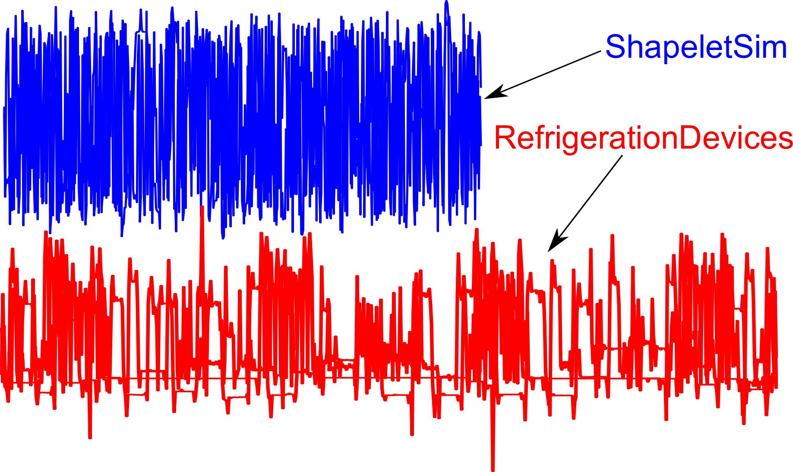
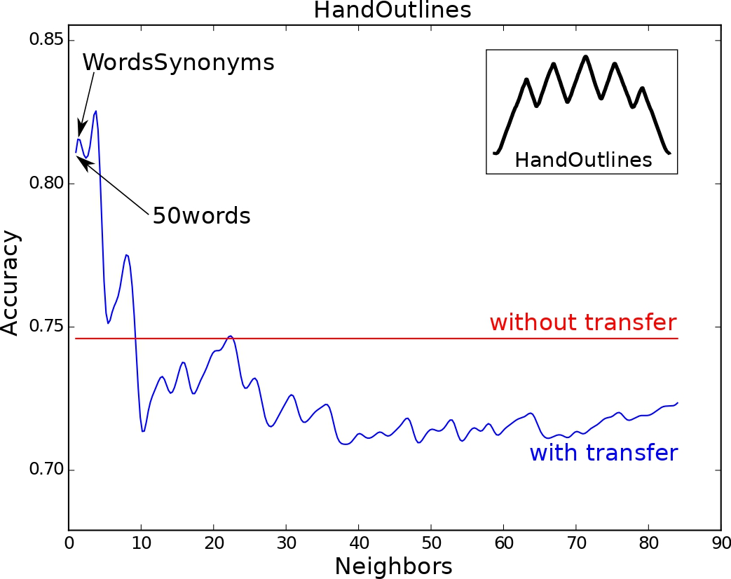
ShapeletSim: has a small size of training set with only 20 training instances & is simulated dataset specifically designed for shapelets which makes it interesting to see how well CNNs can fine-tune (pre-learned) shapelets when varying the source dataset.
Improvement (76% -> 93%)
Reason- source refrigerationDevices dataset has similar spiky subsequences
HandOutliers: Shows huge performance difference (10%) between the model’s accuracy when fine-tuned using the most similar source dataset and most dissimilar source dataset.
Reason- Source 50words, WordsSynonyms are also also words’ outlines extracted from images of George Washington’s manuscripts and also HandOutliers is outlines extracted from hand images.

Slide 20
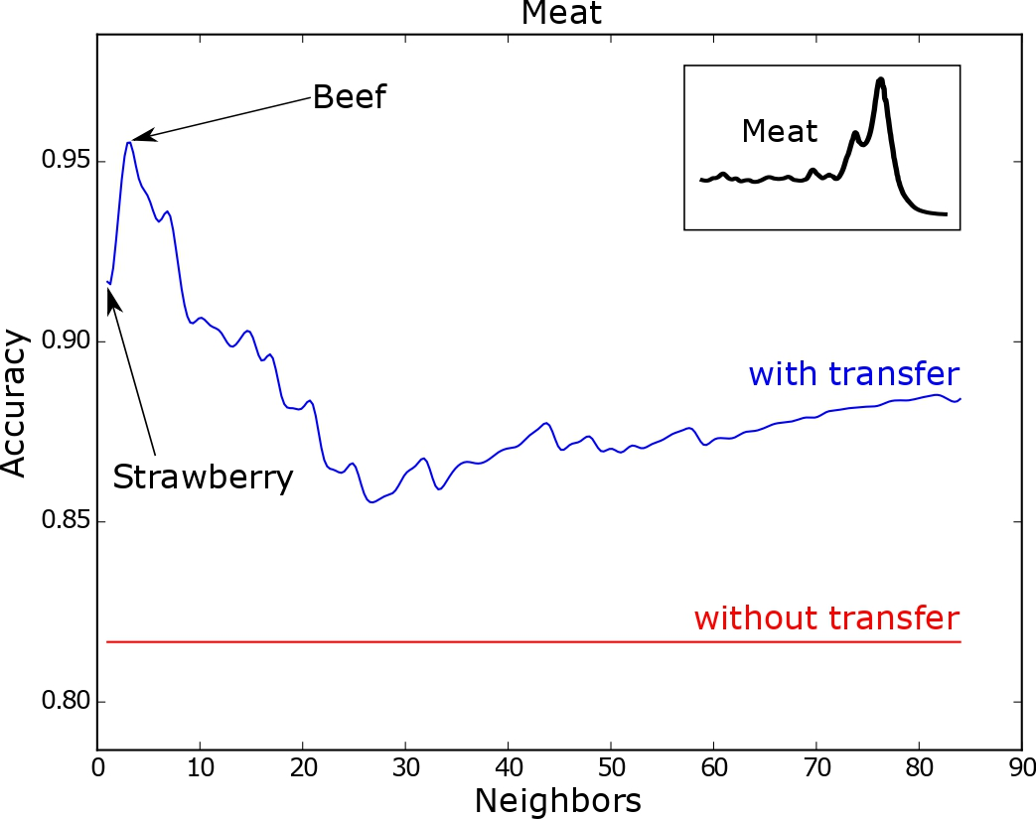
Meat: has a small size of training set with only 20 training instance & transfer learning was always beneficial for accuracy improvement.
Results show improvements obtained for most similar source dataset and the positive transfer learning even for most dissimilar source.
Accuracy improvement = (82% -> 95%)

Slide 21
Conclusion
For transfer learning, the choice of the source dataset could have a significant impact on the model’s generalization capabilities.
When chosen a bad source dataset for a given target dataset, the optimization algorithm can be stuck in a local optimum (negative transfer learning). Thus, when deploying a transfer learning approach, we should give attention to the relationship between the target and the chosen source domains for pre-training the transfer model.
Similarity measure like DTW can be used to obtain best similar source dataset for pre-training CNN model to be fine-tuned on a time series target dataset.
Other similarity measures like- PAD, pruned DTW can also be used to measure dataset similarity.
Thus, we can avoid training models from scratch when classifying time series, but instead fine-tune pre-trained models leveraging the similarity measures. Especially because properly designed CNNs can be adapted across different time series datasets with varying length.
Can achieve accuracy improvements.

